Slide 1
Chapter 7
Taxonomy of Organisms

Slide 2
Taxonomy
Taxonomy derived from two Greek words
"taxis", which means arrangement and
"nomos" which means law
Thus, taxonomy is the law governing the classification or arrangement of organisms into taxa
it is mainly concerned with:
Classification ordering of organisms into hierarchy of ranks based on similarities and/or differences
Nomenclature: naming of organisms
Identification: naming of an organism or a specimen by reference to an already existent classification

Slide 3
Early Attempts to Classify Organisms
The development of modern taxonomy has not a linear path
several attempts have been made
Aristotle (384–322 BC)
Aristotle viewed life was hierarchical and he classified organisms
Theophrastus (370-285 BC)
He was the first taxonomist to write down a classification in a logical form
He classified 480 kinds of plants based on their habit
However, his work incorporates the principle of the rules of dichotomy or Excluded Middle

Slide 4
Theophrastus (370-285 BC) cont’d
According to Theophrastus classification system, there are no any intermediate organisms
Any given organisms is either A or not A
He was typologists, belief that every natural group of organisms has an invariant, generalized or idealized pattern shared by all members of the group

Slide 5
Pliny the Elder (23-79 A.D)
Naturalist who wrote books termed Historia naturalis
Categorized plants in terms horticultural practices, medicinal uses, and timber use practices
Caesalpinus (1519-1603)
In his book "De Plantis" he illustrated about 1500 plant species
He classified plants based on definite morphological criteria mainly on the basis of habit, fruits, seeds, and ovaries and their position

Slide 6
Bauhin J. (1554-1631)
Recognize genera and species as major taxonomic levels
used a binary nomenclature composed of the genus name followed by a single specific
Linnaeus (1707-1778)
The father of modern taxonomy of both animals and plants
Briefly described the genera and the species in his work Genera Plantarum (1737) and Species Plantarum (1753)
His classification system was artificial-which depends only on few characteristics like stamens and pistil number and position
Linnaeus developed a hierarchical classification system

Slide 7
Adanson M. (1727-1806)
Empirical approach
In classification one should use a great range of characters covering all aspects of the organisms without placing greater emphasis on some than on others

Slide 8
Modern Views of Classification (Schemes of Classification)
Classification system of diversified organisms depends up on the combined evidence of
Morphology
Ultrastructure and
Molecular phylogeny
The differences in approach to comparison of character states are lead to the development of five different classification systems

Slide 9
Cont’d
1. Artificial classification system
In this system, only one or at most a few characters are selected for use in making comparison among organisms
Ranking is done subjectively
Artificial system is monothetic meaning
possession of unique set of characters/features is both sufficient and necessary for membership in the group defined
Theophrastus and Linnaeus are good example of artificial system of classification

Slide 10
2. Natural classification system
This classification system is based up on several to many characters selected for their value
This system is therefore polythetic
it places together organisms that have the greatest number of shared features
No single feature is either essential to group membership or is sufficient to make an organism a member of the group
Adanson and De Jussieu are good examples of natural classification system

Slide 11
3. Phyletic or Evolutionary classification system
Classification that aims at reconstructing a sequence starting with the most primitive character and ending with the most advanced or derived character
It ensures that each taxon recognized as a monophyletic i.e. has arisen by the diversification of a single ancestor
is made primarily by examining the fossil record to discover which character states are nowadays more common and which are less common than earlier

Slide 12
4. Phenetics classification system
developed based up on numerous characters of equal weight and their comparison is using computer program
According to Harrison (1960), the word "Phenetic" is a relationship by overall similarity of all available morphological characters
Thus, Similarity/resemblance is determined based on a set of phenotypic characteristics of organisms (numerous characters of equal weight)

Slide 13
Phenetics classification system cont’d
The following methods/approaches are used for determining the similarity of the studied organisms
Selection of taxa-called Operational Taxonomic Units (OTUs) for study. Thus may be species, genera or families.
Selection of character states (minimum of 60 and 80 -100 are desirable for comparison)
Description or measurement of character states
Ranking of all OTUs into the categories of the taxonomic hierarchy

Slide 14
5. Phylogenetic classification system
Is the concepts and methods of determining similarity by constructing branching patterns of evolution
The method works as follows:
Select monophyletic taxa
Select characters of evolutionary interest
Describe and/or measure character states
Determine homologies of characters and character states
Generate trees or cladograms
Once the cladogram or tree of life is generated, it is possible to construct classification based upon the cladogram

Slide 15
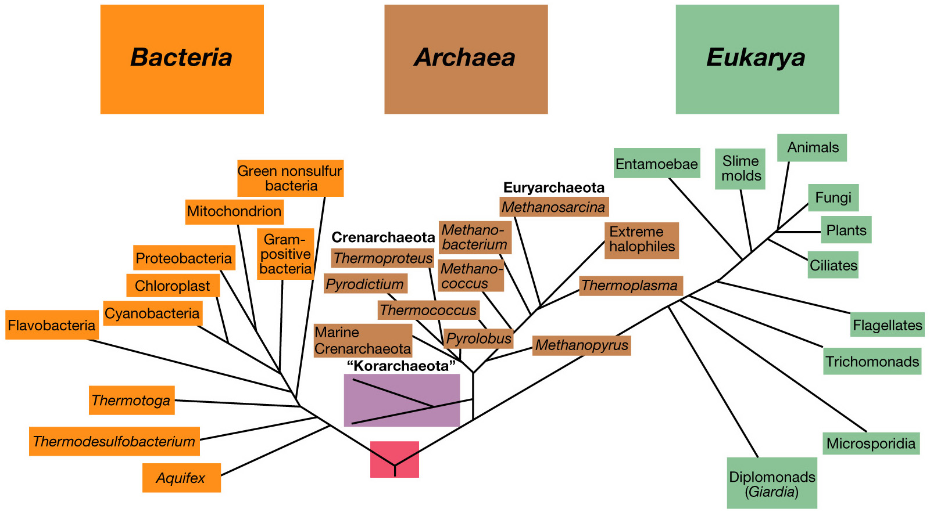
Fig. The universal phylogenetic tree derived from rRNA sequences

Slide 16
Domains of Life and the Hierarchical System of Classification
Hierarchical Classification System
An arrangement of taxa into an ascending series of ever–increasing inclusiveness forms
In a hierarchical system, we start at the bottom with individuals (species) and end up at the top with one all-embracing taxon (Domain)

Slide 17
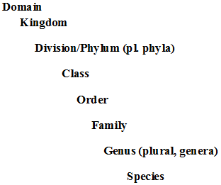
Cont’d
The major levels in the hierarchy are the following

Slide 18
Concepts of the Kingdom
There are different approaches of Kingdom developed based on the diversity of organisms to produce inclusive all-inclusive classification system.
1. Two- Kingdom Concept
This concept was classifying organisms based up on the cell wall present or absent
Thus, Kingdom Plantae and Kingdom Animalia were identified
After the invention of the Electron Microscope, some naturalists later questioned this approach
clamed for improper classification of the intermediates, like some algae and protozoa, which behave like both plants and animals

Slide 19
2. Three-Kingdom Concept
This kingdom concept classifies all organisms in to three Kingdoms, namely;
kingdom Plantae
Animalia and
Protista (for the intermediates like some algae and protozoa, which behave like both plants and animals)
Still there are properly ungrouped organisms fungi

Slide 20
3. The Four-Kingdom Concept
This kingdom concept classifies organisms in to four Kingdoms, namely;
Kingdom Plantae
Kingdom Animal
Kingdom Protista and
Kingdom Fungi

Slide 21
4. Five-Kingdom Concept
Following the invention of the Transmission Electron Microscope, some biologists were able to investigate the composition of the cell
found that there are differences in the composition of the cells of few groups of organisms that were considered members of the Kingdom Plantae and some members of the Kingdom Animalia
This concept suggests the Five Kingdom approaches namely
kingdom Monera
Kingdom Fungi
kingdom Protista
kingdom Plantae and
kingdom Animalia

Slide 22
5. Six-Kingdom Concept
This concept classifies first kingdom monera in to two groups based on the nucleus and other organelles (having or lacking a membrane)
Thus, the six kingdom system was developed. These are:
kingdom Archaebacteria,
Eubacteria
Protista
Fungi
Plantae and
Animalia

Slide 23
Binomial Nomenclature
Nomenclature is the naming of organisms and the rules governing the application of these names
In nomenclatural system, each organism is designated by two names
the first is the name of the genus
the second is the specific epithet
No two species can have the same name
The names are always Latin (Latinized) and the genus is capitalized while species name is not

Slide 24
The Purpose of giving names to organisms
Name is a conventional symbol or code that serves as a means of reference
Purpose
Easy communication
Avoids the use of an inconvenient descriptive phrase
To universalize the organism

Slide 25
International code nomenclature
The code is a rulebook that contains principles, rules and recommendations which form the basis of the system of nomenclature.
the code provides stability in the naming and classification of organisms and ensures that any given taxonomic grouping of a given rank can have only one correct name, by which the species is known
Varies international codes are established for different groups of organisms (plants, animals, fungi, bacteria, cultivated plants)

Slide 26
Cont’d
For this reason sets of rules have been drawn up
International Code Botanical Nomenclature (ICBN)
naming of groups of plants (including algae, fungi and lichens)
International Code of Zoological Nomenclature (ICZN)
International Code of Nomenclature of Bacteria
International Code of Nomenclature for Cultivated Plants
International Organizations & Unions for the Stabilization of Changes

Slide 27
Operative Principles of Nomenclature
The nomenclature code has set certain provisions, called Operative Principles of Nomenclature. These provisions are
Publication
Typification and
Priority

Slide 28
Cont’d
Publication
Publication is the means by which scientific names enter to the biological nomenclature system
Two basic conditions must be fulfilled before a properly formulated scientific name
The name must be published in works that are printed in permanent and made available to the interested public
A name must be accompanied by a written matter or a reference to such description

Slide 29
Typification
A type is an element on which the description associated with the original publication of a name was based
In nomenclature, there are different kinds of "Types". Some of these are:
Holotype
It is the sole element used or designated by the author of a name as a type
Isotype
The duplicates of a holotype

Slide 30
Typification cont’d
Syntype
Any one of two or more elements used by the author of a name who did not designate a holotype
Lectotype
Is an element selected subsequently from amongst syntypes to serve as a type
Neotype
An element selected to serve as a nomenclatural type when through loss or destruction of the above "Types“

Slide 31
Priority
The principle of priority requires when two or more names apply to the same taxon
In this case, the name is given generally based up on by the oldest one, which is validly published name
In nomenclature, when two or more names are applied the same taxon, it is known as synonyms

Slide 32
Priority cont’d
There are two kinds of synonyms
Nomenclatural
based on the same ‘ type‘ of the organism and called obligate or homotypic synonyms
2. Taxonomic synonyms
based on different ‘type‘ of an organism, and called heterotypic synonyms

